Slide 1
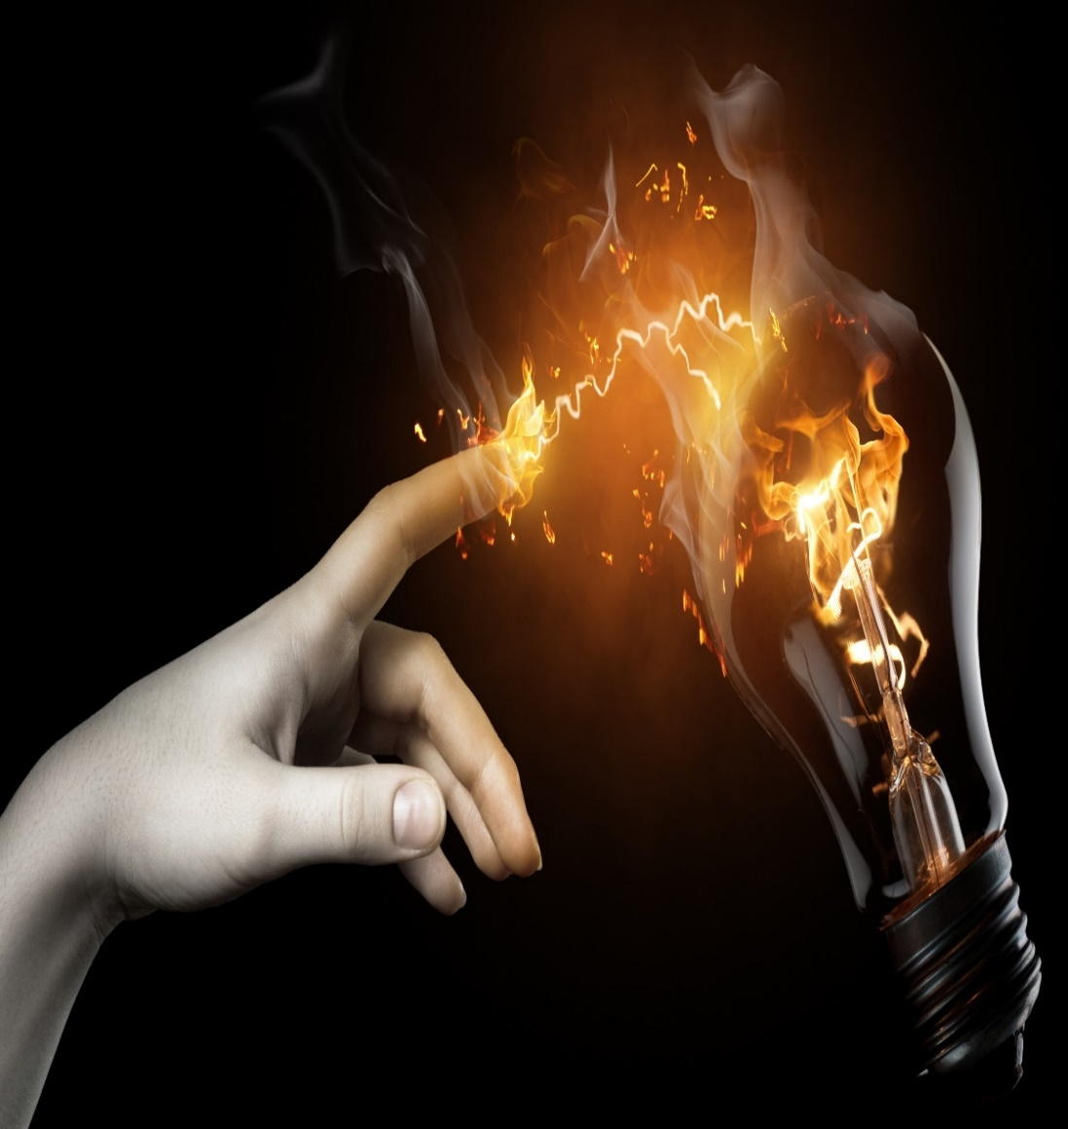


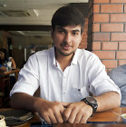

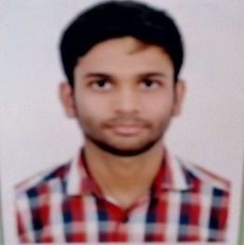
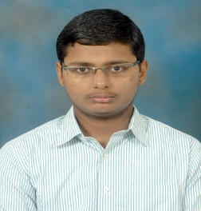
Real-time object tracking system using multiple cameras PID _0001626
Team: Corona
VELLORE INSTITUTE OF TECHNOLOGY
Technical Presentation on
Photo
(Author 1)
Photo
(Author 2)
Photo
(Author 2)
Photo
(Author 2)
Shivam
Srivastava
Anupam
Bisht
Rishu
Sinha
Sanjay
MS
Notes:
Title Text Font Calibri Body Bold, Font Size 34, Name and Designation Font Size 18

Slide 2

Index
1
Challenge Statement
7
Implementation/ Proto/POC
2
Concept /Scope of Solution
8
Validation / Testing / Analysis
3
Pros and Cons of the solution
9
Cost /Benefit
4
Detailed Description
10
Results and potential Business Impact for L&T TS
5
Technology /background
11
Conclusion
6
Development Procedure / Methodology
12
References

Slide 3
Challenge Statement

Slide 4

Challenge Statement
TO DEVELOP MULTI-CAMERA MULTI TARGET VISUAL TRACKING SYSTEM

Slide 5
Concept / Scope of solution

Slide 6

Concept / Scope of solution
We proposed an intelligent multi-camera tracking system which is capable of-
Identifying people depth order(Height).
Handle body occlusion.
Compare observations across cameras.
Classifying among different objects/people.
Recognize people when re-entering.

Slide 7
Pros & Cons of the solution

Slide 8
Pros and Cons of the solution
High object detection accuracy
Relatively higher cost
Robust visual tracking
P R O S
C O N S
Object Re-identification is possible
vs
Improved body occlusion handling
Complex System Implementation
High Computational Efficiency

Slide 9
Detailed Description

Slide 10


Detailed Description
(Local Detectors)
To the Central HUB
Camera 1
Camera N
Objects
Identify people depth order
Body Occlusion Handling
1) Local Trackers

Slide 11

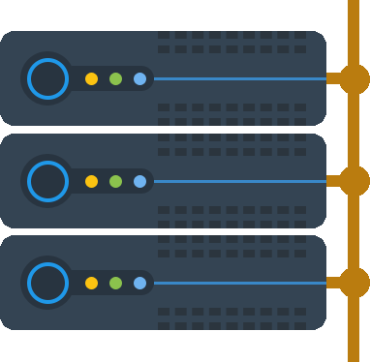

2.) Central Server
Compare observations across cameras
Data
Acquired
1
Cycle
Repeated
Central
HUB
(Raspberry Pi)
Server Updated
Cloud Database
Updated
Object recognition for repeated entry
Object Classification
3
2

Slide 12
Technology / Background

Slide 13

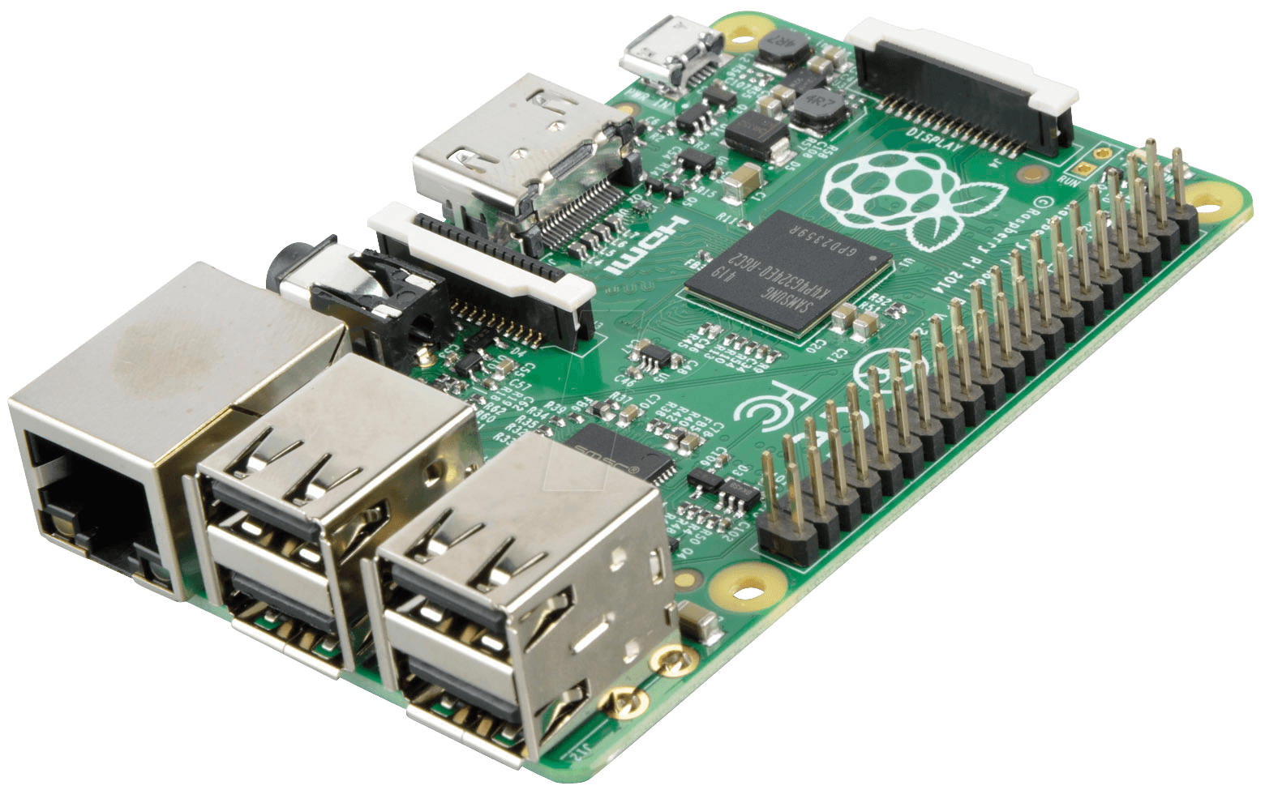

Technology/Background
MATLAB is a high-performance language for technical computing. It integrates computation, visualization, and programming in an easy-to-use environment where problems and solutions are expressed in familiar mathematical notation.
The Raspberry Pi is a low cost, credit-card sized computer that plugs into a computer monitor or TV, and uses a standard keyboard and mouse. It is a capable little device that enables people of all ages to explore computing, and to learn how to program in languages like Scratch and Python Raspberry Pi has the ability to interact with the outside world, and has been used in a wide array of digital maker projects.
Different algorithms which include classification algorithms, Kalman filter, Prediction based algorithms, etc.

Slide 14
Development Procedure / Methodology

Slide 15






Development Procedure
03
04
IMPROVISING
VALIDATION
Working with existing algorithms and improvising them
Testing and validating our algorithms
06
01
POC
START
Proof of concept
Ideation
02
ALGORITHM
05
Studying about different algorithms and collecting datasets
HARDWARE
IDEA TO PRODUCT
Hardware purchase & Implementation

Slide 16

Methodology
Moving Object Detection
Camera 1
Body Occlusion Handling
Camera 2
Object Classification
Camera 3
Image Segmentation
Server Update
Display/GUI
Camera 4
Sensing Unit
Object Re-identification
Processing Unit

Slide 17
Implementation / Proof of concept

Slide 18
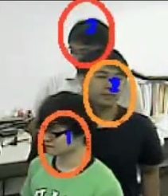





Implementation and prototype / POC
Identification of Depth Order-
Earlier used method-By appearance (object color, shape)
By 3-D standing locations of Objects,
this is accurate & is independent of
occlusion
C
Our Innovation
B
dC
A
dA
Camera Image
dB
dA<dB<dC => Depth order: A=1, B=2, C=3

Slide 19
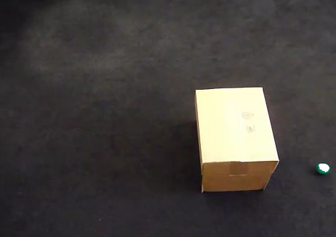
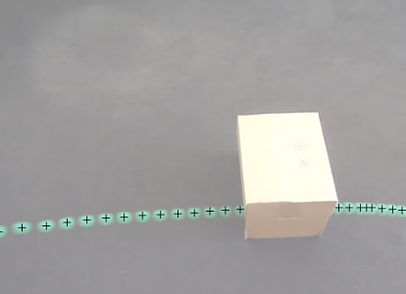
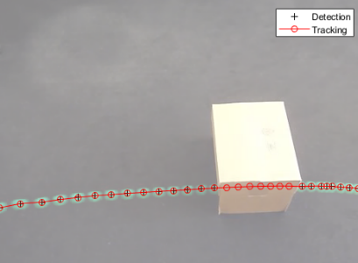
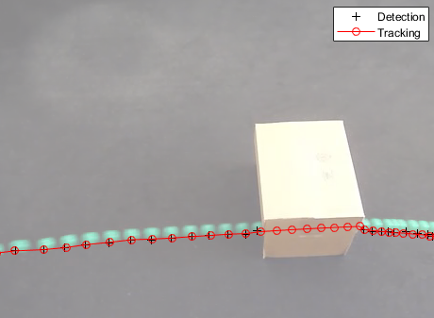
Implementation and prototype / POC
Body Occlusion Handling-
Occlusion handling becomes easier when it comes to multiple cameras once object is detected.
Here we have used Kalman filtering in order to get rid of body occlusion.
Kalman filter helps to track the object’s path once it is occluded or hidden by some other object.
A ball passing through a box
Displaying trajectory of ball
Tracking using Kalman Filter
Predicted trajectory & actual one.

Slide 20
Implementation and prototype / POC
Compare observations across cameras-
Geometry based color comparison.
Optic Center
Image plane of camera k
Optic Center
Image plane of camera j
Head Point
Observation r
Observation q
Height
Estimated Standing Location

Slide 21
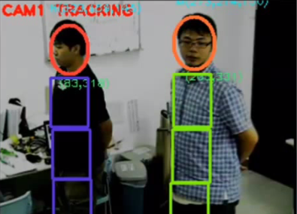
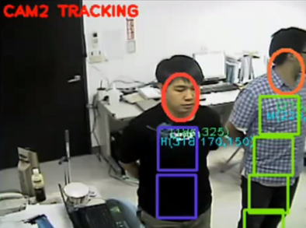
Implementation and prototype / POC
Object Classification-
This is done in three steps, use decisions in higher confidence to determine lower ones.
Matching Body Color: Block based color comparison of the object across camera frames.
2) People depth order across camera frames
3) People trajectory across camera frames.
Object Confidence = 2
Object Confidence=3
Camera 1 tracking
Camera 2 tracking

Slide 22
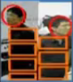

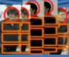
Identify people when re-enter: Construct people database once they got tracked.
Camera Observation
No, if difference>threshold
No, if color is unmatched
Check height difference
Body color comparison by block
Label history consistency
Object model database
Match Confirmed

Slide 23
Validation / Testing / Analysis

Slide 24
Validation / Testing / Analysis
Following testing and analysis are done on 4 camera frame dataset taken from CVLabs website

Slide 25
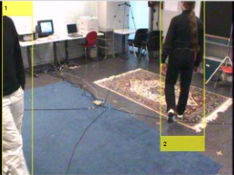
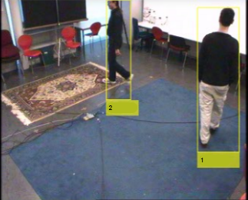
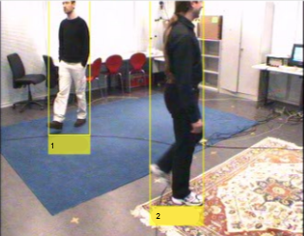
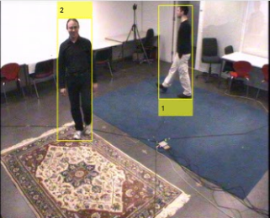
Object Tracking Analysis
Object 2
Object Successfully tracked for 4 camera frame dataset
Object 1

Slide 26
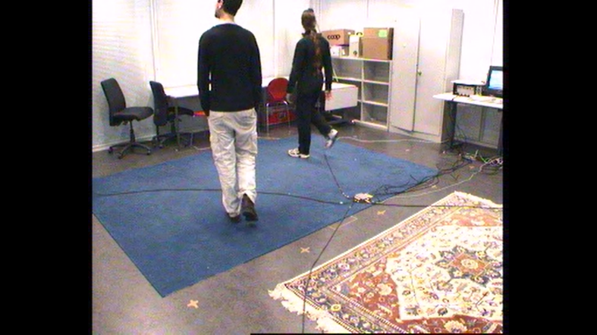
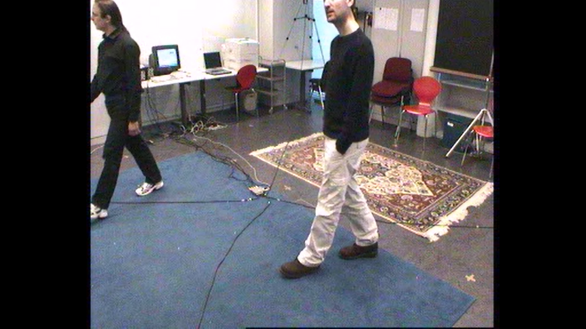
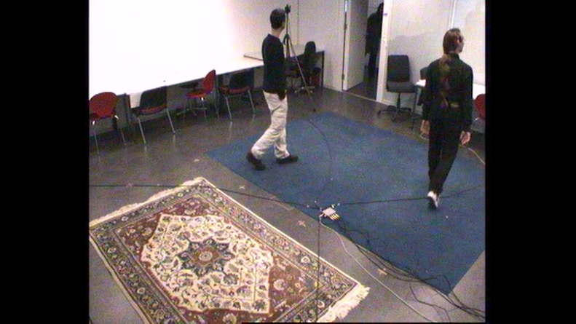
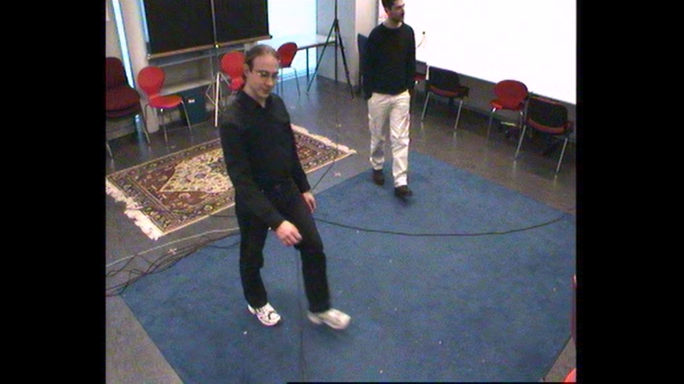
Depth Order Testing
1
2
Object 1
1
2
1
Object 2
Object Depth order determined for 4 camera frame dataset
1
1
2
2

Slide 27
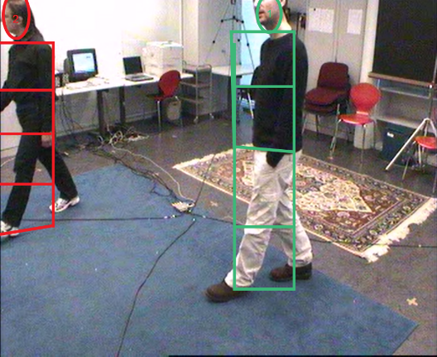
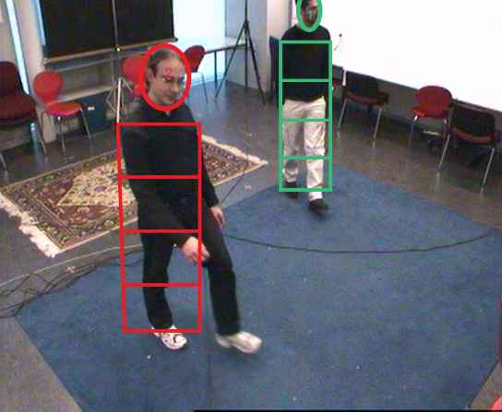
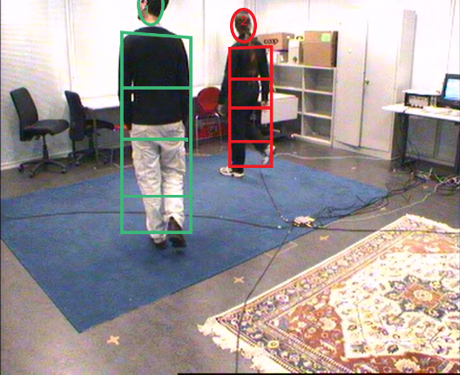
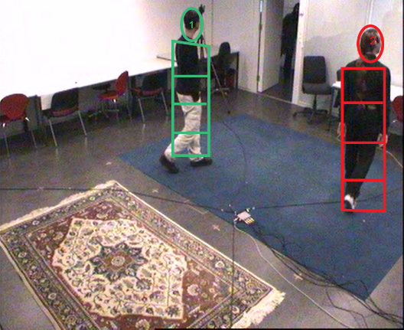
Object Classification Analysis
Object 2 Classified with 100 % confidence limits
2 objects & 4 cameras, both the objects are classified with confidence factor=4
Object 1 Classified with 100% confidence limits

Slide 28
Body Occlusion Handling is Yet to be tested on the 4 camera frame test dataset

Slide 29
Cost & Benefits

Slide 30

Cost & Benefits
Why our system?

Slide 31

Raspberry pi 3
INVESTMENTS
Camera Module
One Time Investment
Hardware Cost
Installation Cost
Memory
Per Year
Regular Service
400
800
1200
1600
2000
2400
2800
3200
3600
4000
4400
Amount in ₹.

Slide 32


₹ 2400
₹ 7400
Total Cost
Total = ₹ 9800

Slide 33

Large Scale implementation Cost Analysis
ASIC
LARGE
SCALE
Camera Module
One Time Investment
Hardware Cost
Installation Cost
Memory
Per Year
Regular Service
400
800
1200
1600
2000
2400
2800
3200
3600
4000
4400
Amount in ₹.

Slide 34
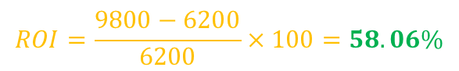
Head-on comparison of both implementation
₹. 3600
₹. 1800
RaspberryPi
Camera
Hardware
Installation
Memory
Service
ROI=Net Profit / Total investment * 100
; ROI: Return on investment
$$ROI=\frac{9800−6200}{6200}×100=58.06\%$$

Slide 35


Cost of doing magnetic finger printing and calculating number of person in a given zone.
Cost of installing sensors to track object location.
Payback= Robust high-end security system

Slide 36
Results & potential business impact for L&T TS

Slide 37



Results and potential Business Impact for L&T TS
First of its kind in the market, capable of tracking many people simultaneously can certainly boost up the sales exponentially.
Large scale implementation is very economical which will bring a new era of surveillance and security system
Novel system for object identification, positioning and tracking with fast and accurate algorithms

Slide 38
Conclusion

Slide 39



Conclusion
TRACKING
ALGORITHM
TESTING
COST
Fast & Robust visual tracking system with successful validation
Fast and computationally efficient algorithms deployed
Algorithms successfully validated using the test dataset
Optimum cost with state of the art functioning

Slide 40
References

Slide 41
References
J Berclaz, F Fleuret, E Turetken, and P Fua, "Multiple Object Tracking Using K-Shortest Paths Optimization," IEEE Transactions on Pattern Analysis and Machine Intelligence
J Black, T Ellis, and P Rosin, "Multi view image surveillance and tracking," in Workshop on Motion and Video Computing
R.E. Kalman, "A new approach to linear filtering and prediction problems," Journal of basic Engineering
G. Welch and G. Bishop, "An Introduction to the Kalman Filter," Computer Science, University of North Carolina at Chapel Hill
R. Burkard, M. Dell'Amico, and S. Martello, Assignment Problems: Society for Industrial and Applied Mathematics

Slide 42





THANK YOU -TEAM CORONA
shivam.96ss@gmail.com
9585600396

